Slide 1
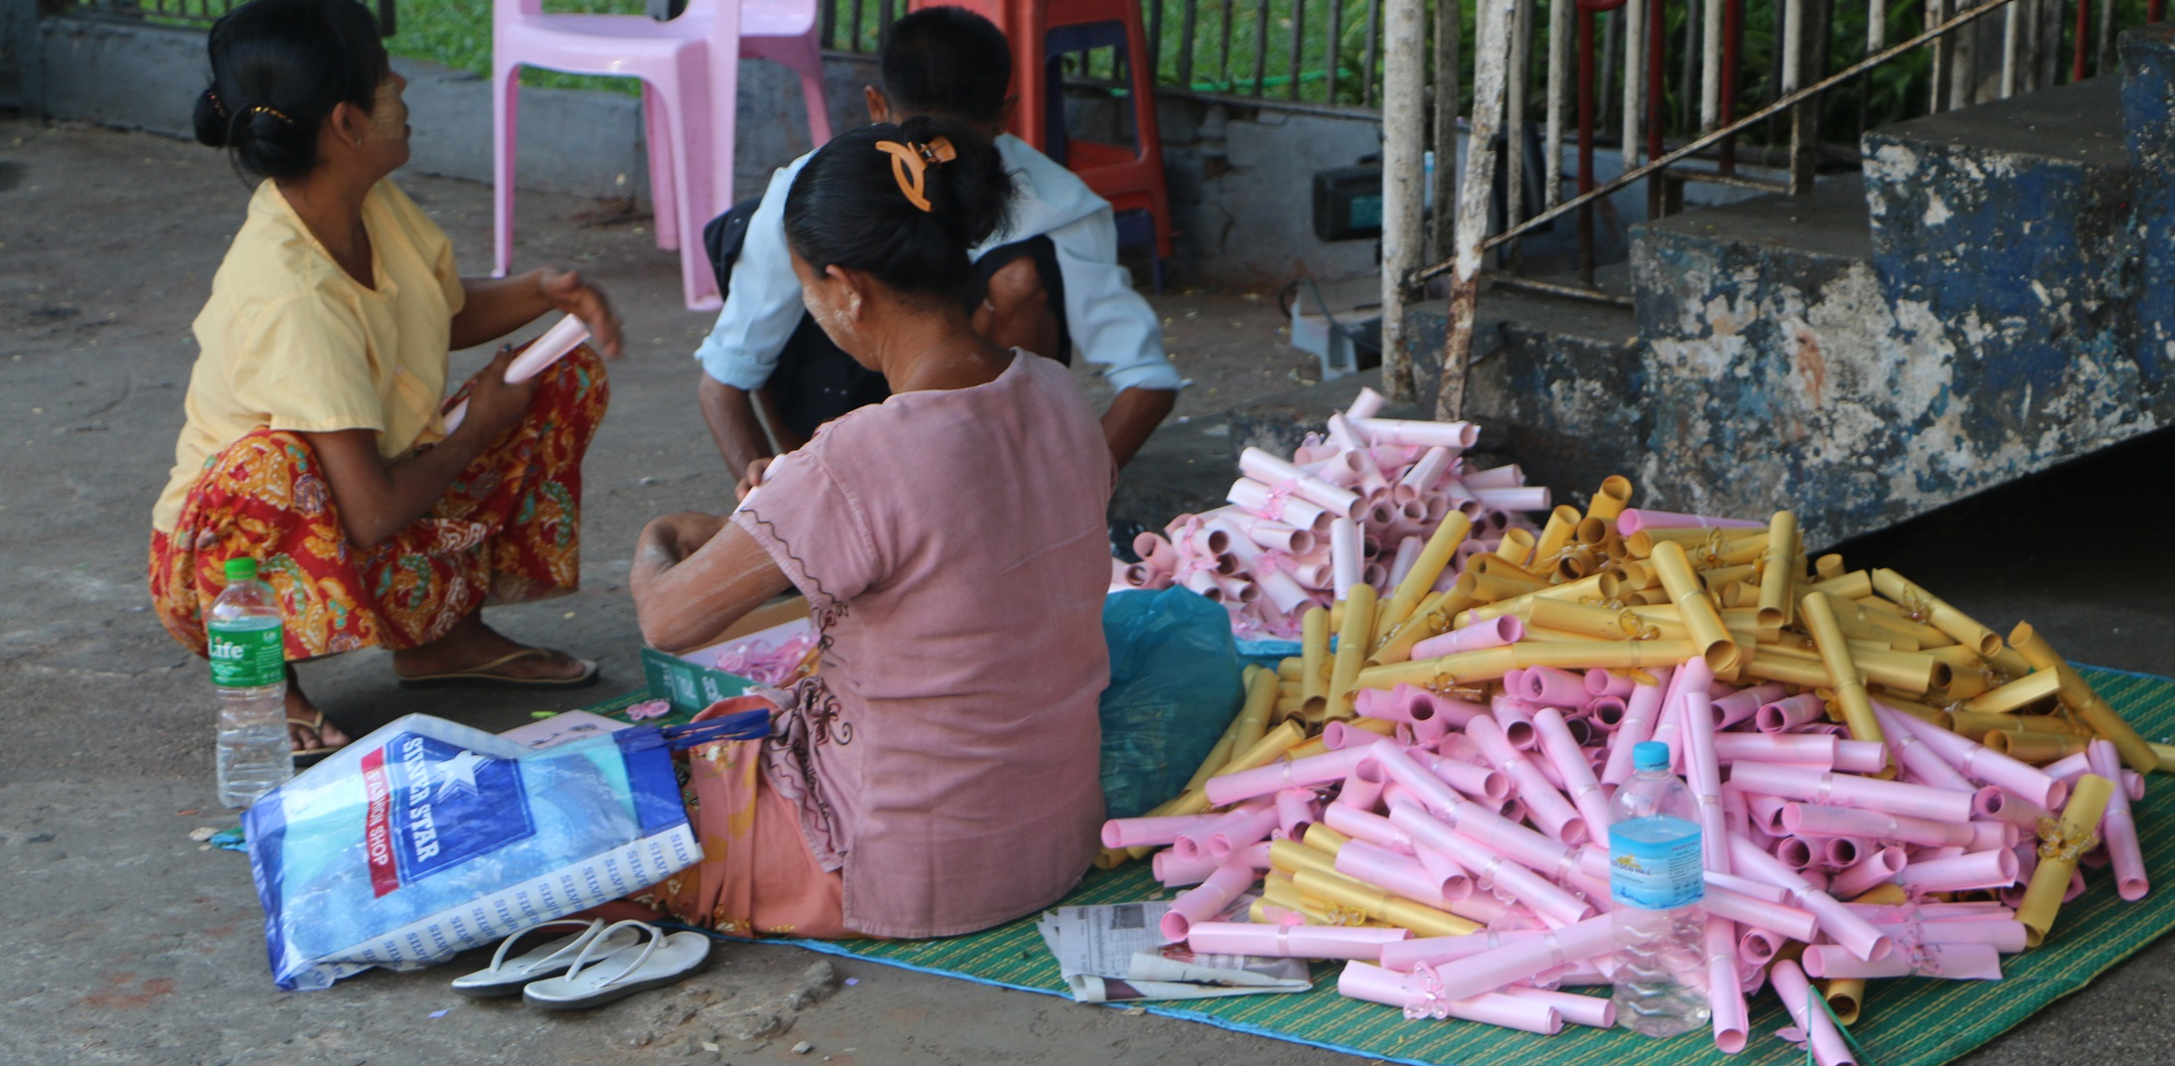
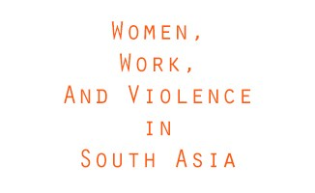
Myanmar: Exploring the relationship between women’s income generation and their experiences of violence

Slide 2
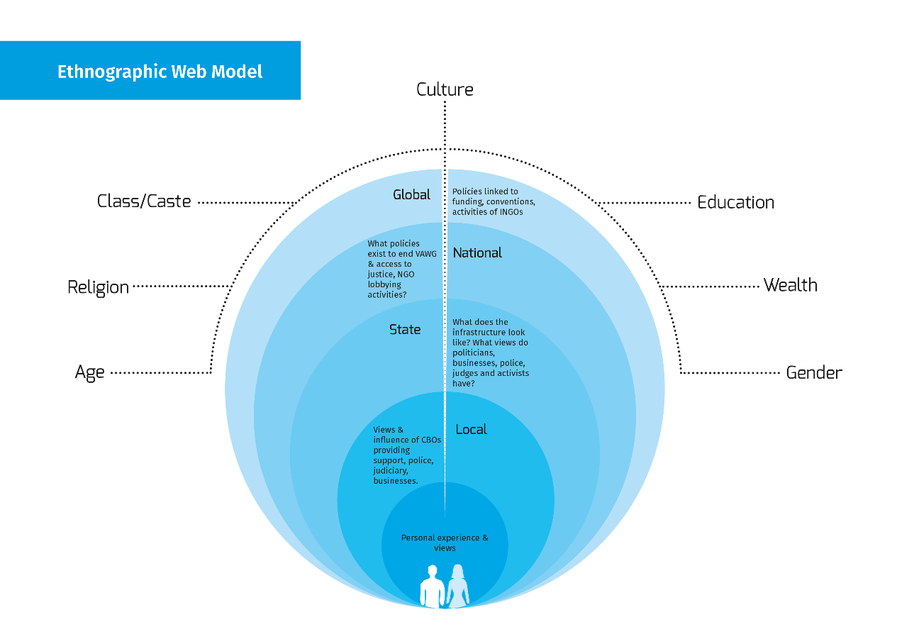

Slide 3
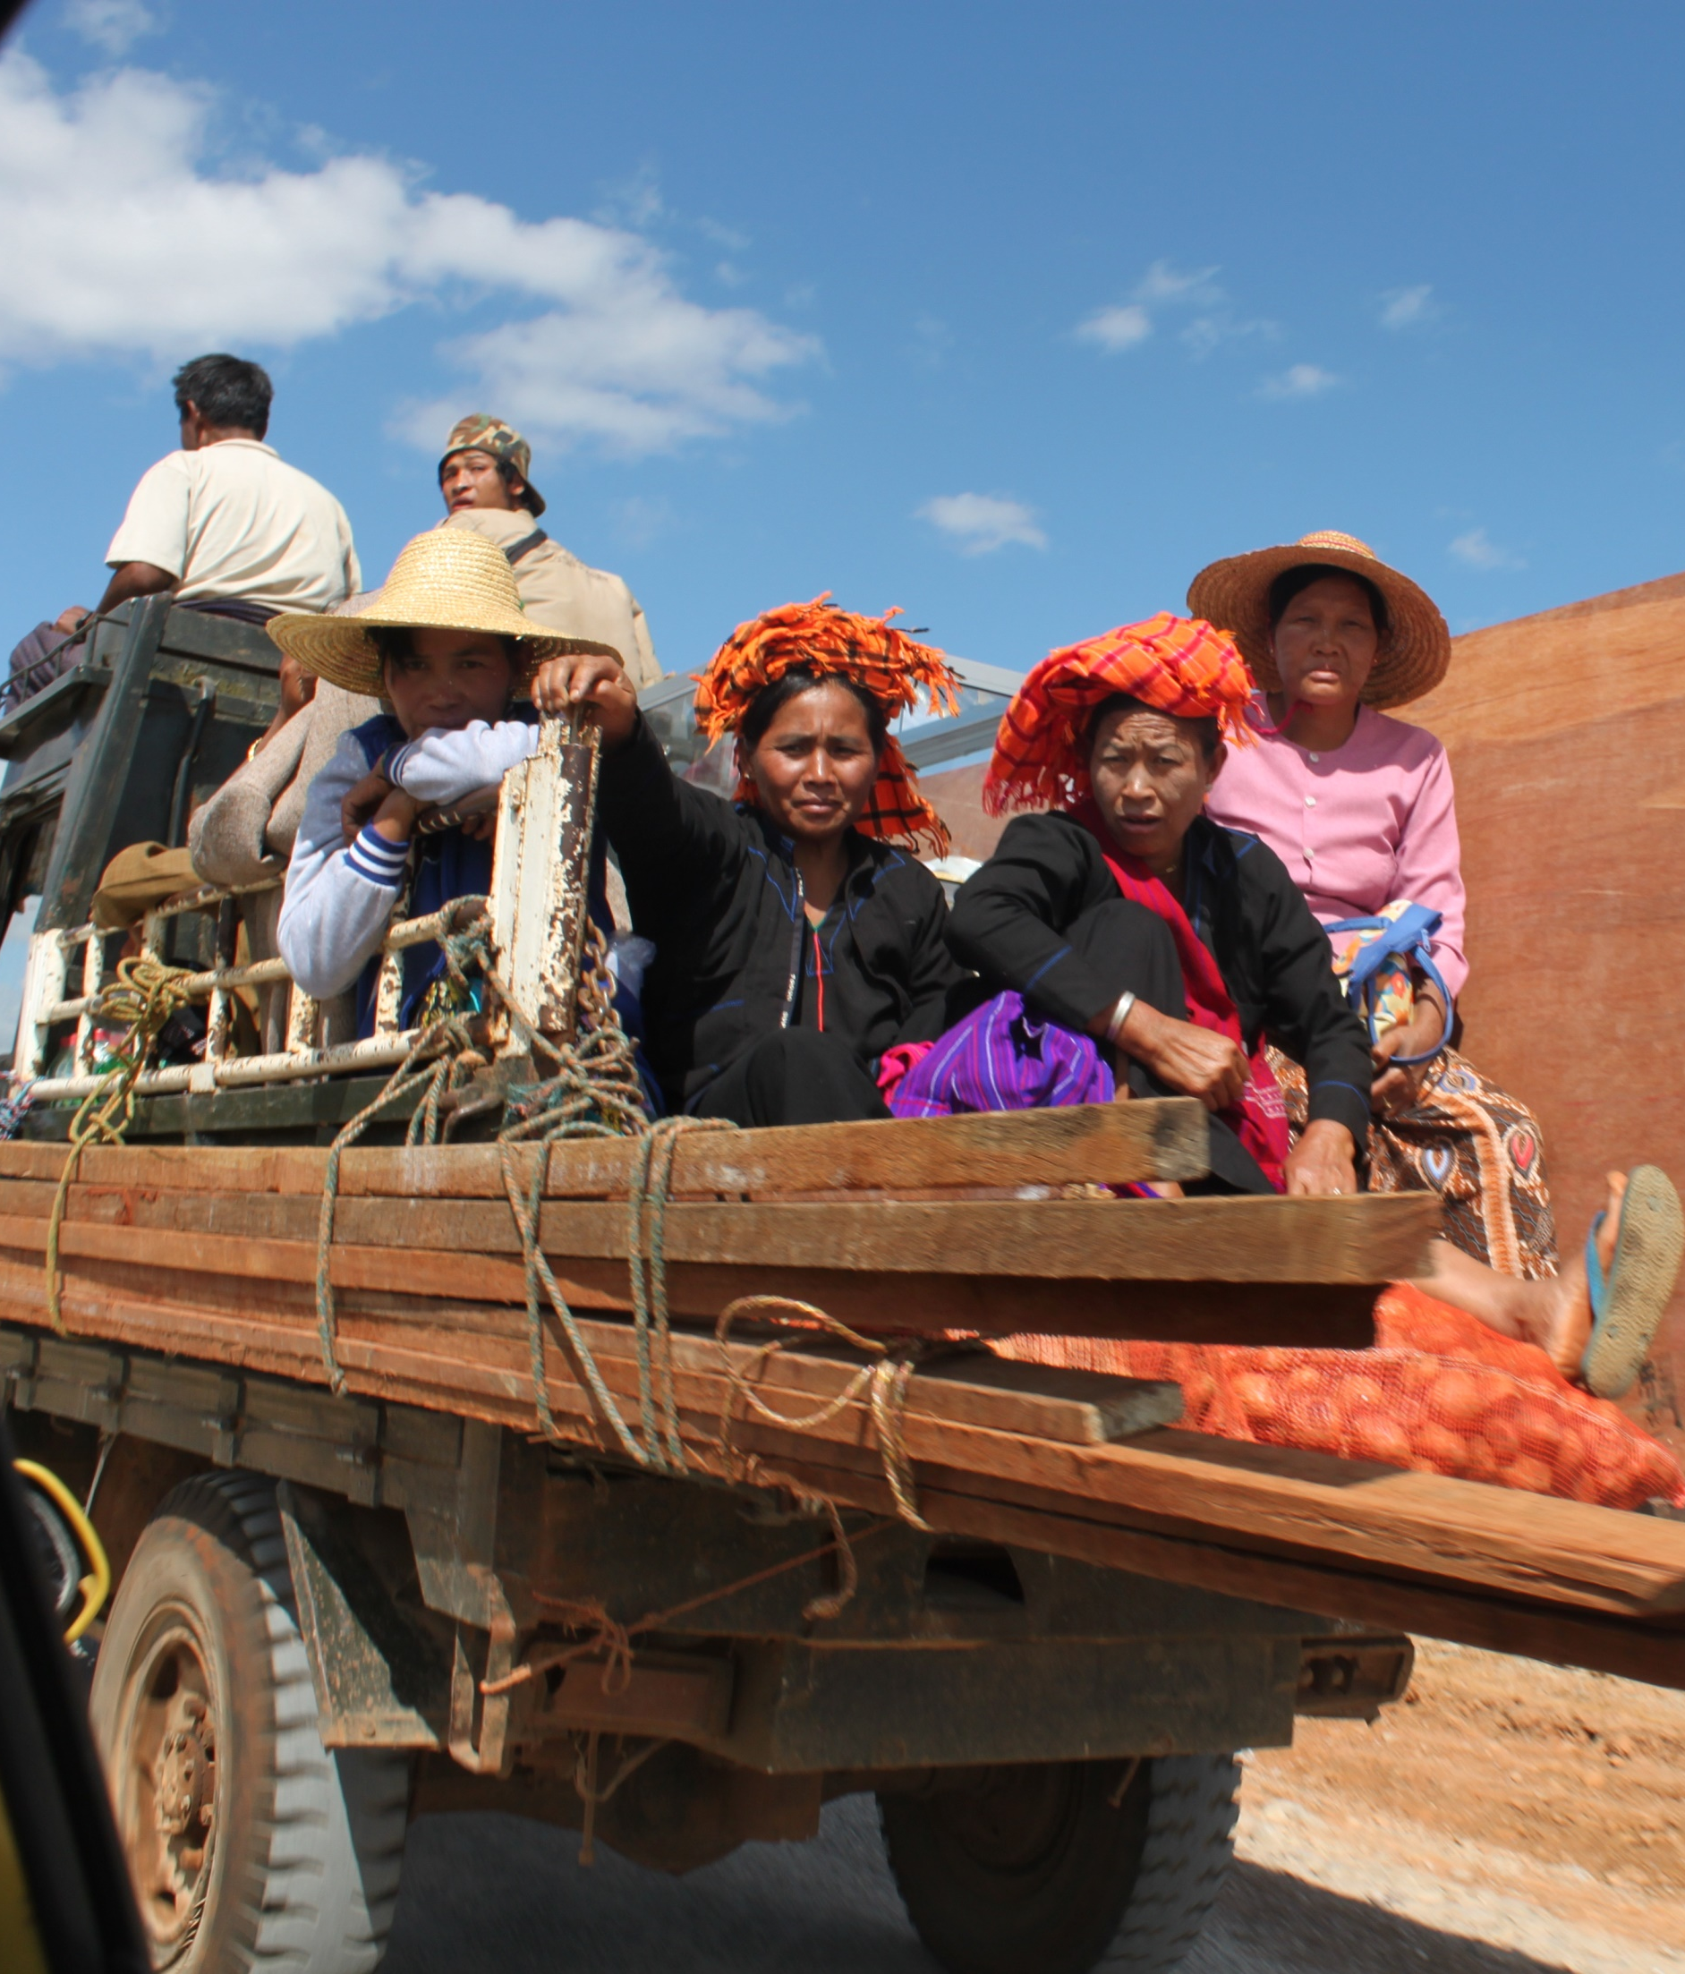
Out from the individual level
“Out of 10 women, 9 may experience domestic violence.”
“Very recently, a husband drunk and beat his wife’s face. And again, beat with a kettle until the entire kettle was ruined…”
“If I have money, I will challenge violence that my friends experience. If I have no money, I will not.”

Slide 4
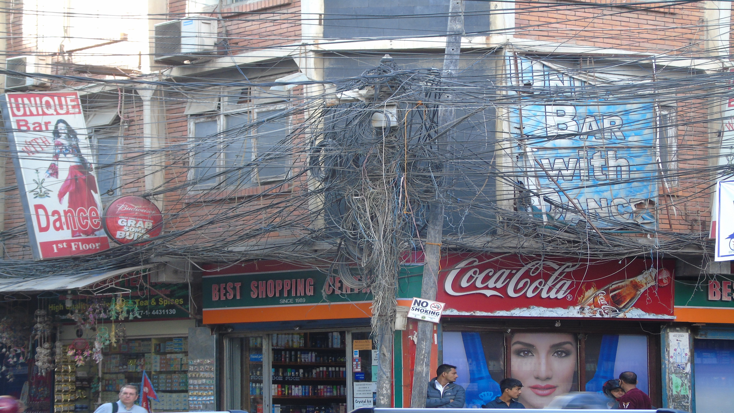
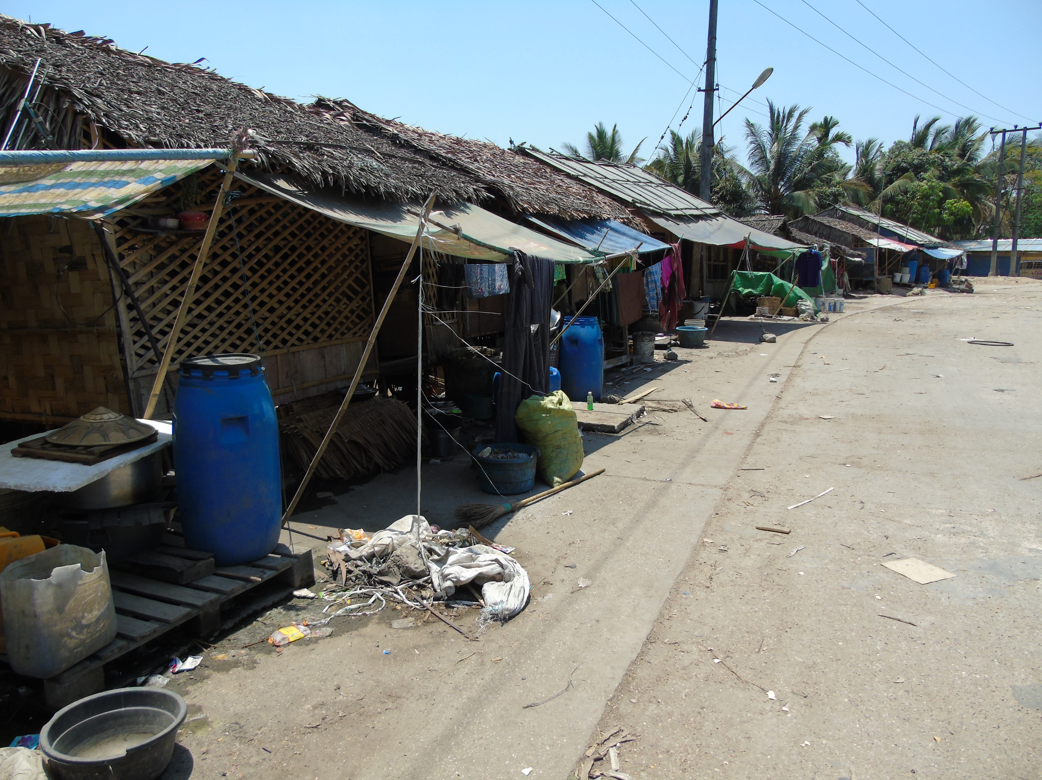
Out from the household level
Women, work and household relationships
“A woman is the same (equal) with us. She should work when I work equally.
She is not a disabled person. She must do what she can… I won’t be
happy if she doesn’t want to work.”
“The one who arrives home early does work house chores without separating
chores.”

Slide 5
Out from the community level
Violence at work
“We are always watched via CCTV. We can’t speak to each other even in
lunchtime. If we want to eat some snacks, we have to eat standing under
the sun. Manager is authorised to dismiss a worker in her provisional
period without compensating.”
Violence while commuting
“Teasing or touching private parts on the bus is always happening.”
“He followed me quickly in a dark place. When I had run to a brighter
place, I hit him with my steel lunch box and then I ran into the nearest
house.”

Slide 6

Out from the society level
Social Norms and Patriarchy
“In my generation, women wear western style clothes which is not traditional. That invites harm for women.”
Structural factors
Legal structures need to be implemented more effectively, and be separated from cultural bias.

Slide 7
Intersectional analysis – Pulling out the differences
Age
Marital status
Migration
Class

Slide 8
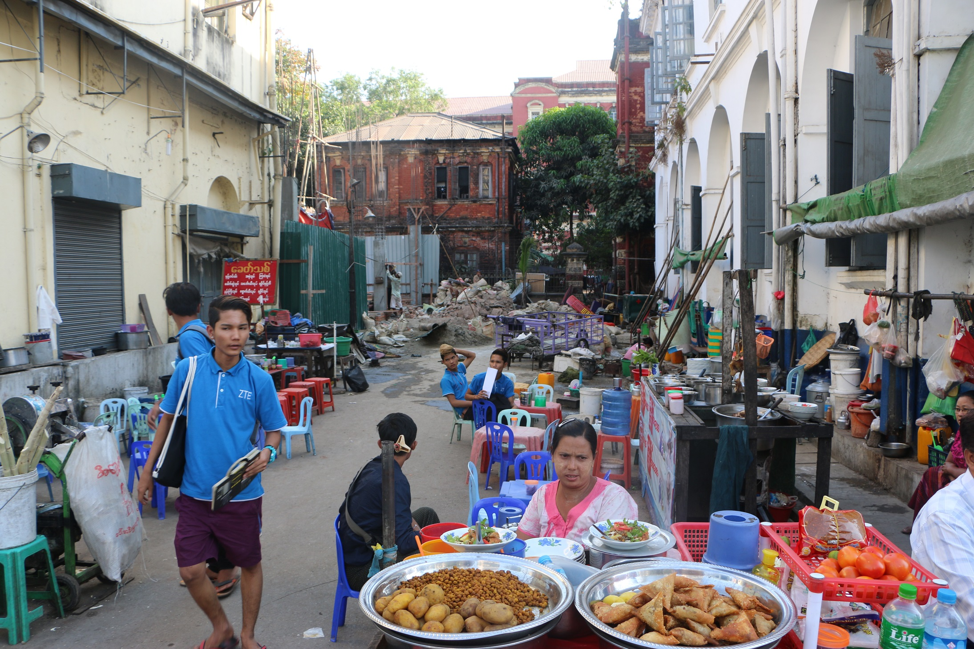
Out from the national level – Recommendations
Engaging CSR: gender equity and fair working practices
Protection in public spaces, especially in relation to transport
Promotion of women’s collectives
Social mobilisers

